Slide 1
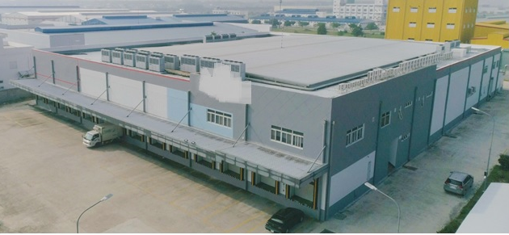
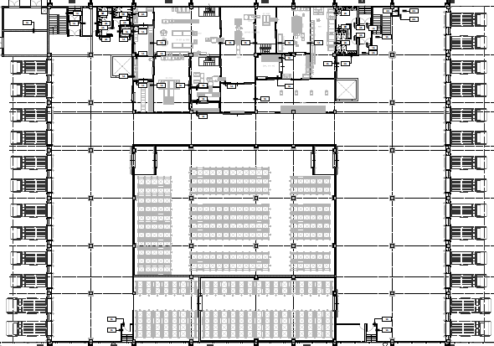
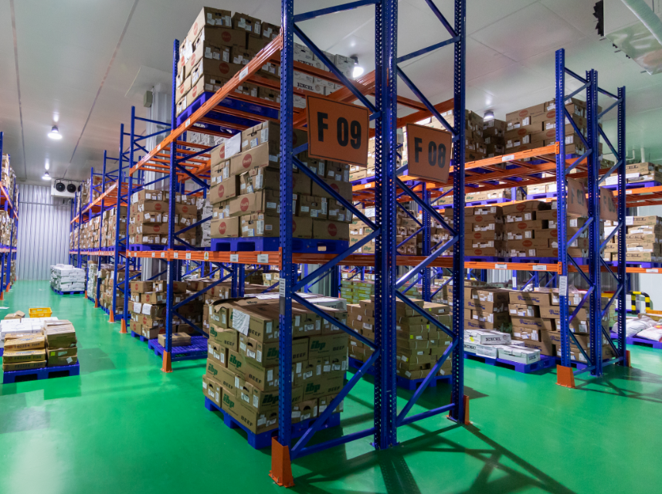
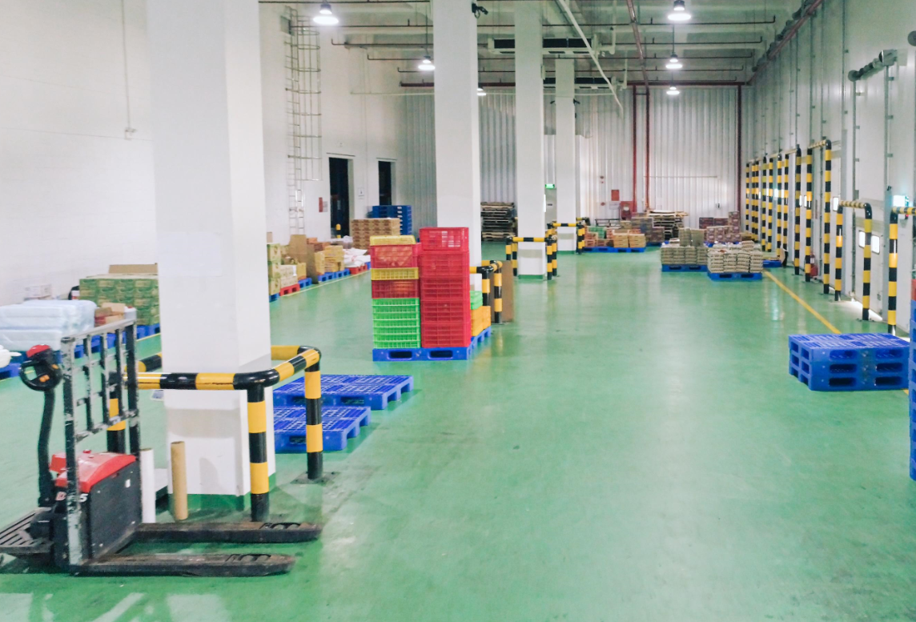
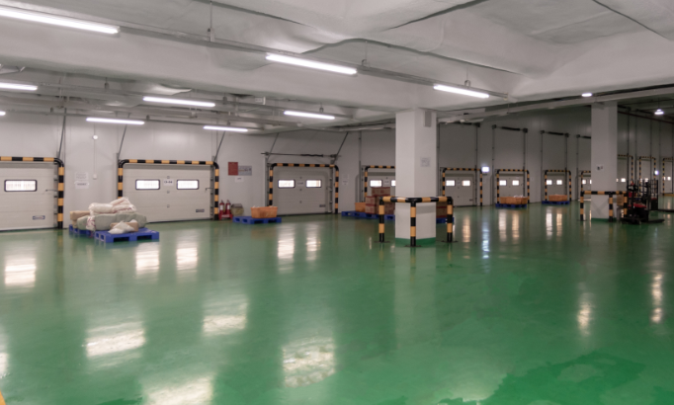
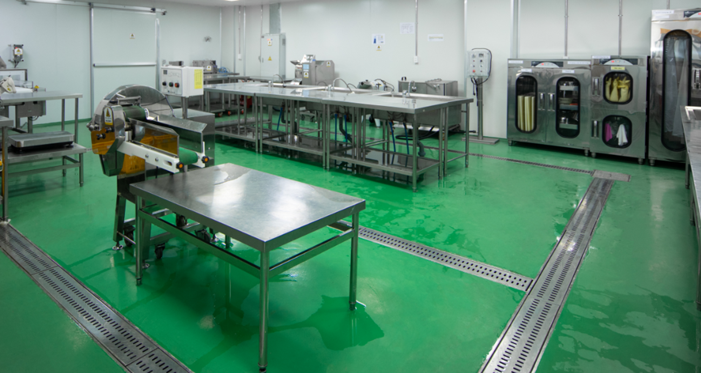
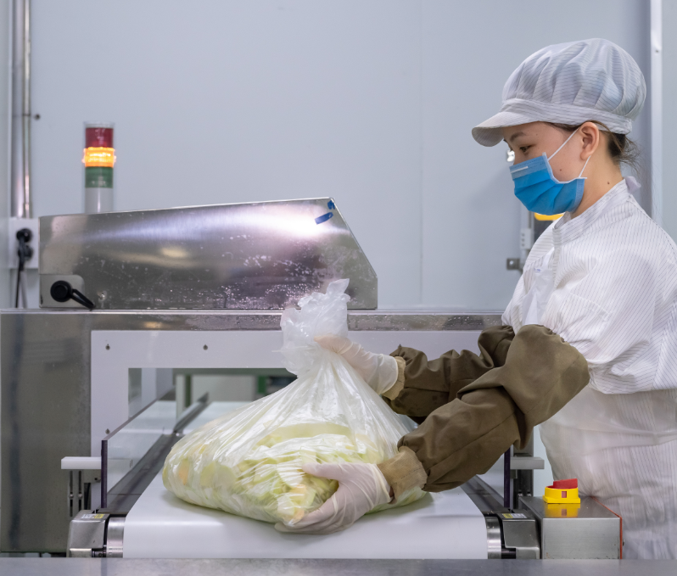
SPECIAL SALE
Illustration Photo
General Information
Price(without VAT)&Available Area
Land Area | 9,900㎡
Building Area | 5,474㎡
Ask Price | negotiable
Layout & Inside
Specification
1F : Warehouse & Other | 4,165㎡
2F : Office & Other | 1,309㎡
Sơ chế
KV
Đợi Nhập Kho
KV
Đợi Xuất Kho
1
Kho đông
Kho mát
Kho lạnh

